Slide 1
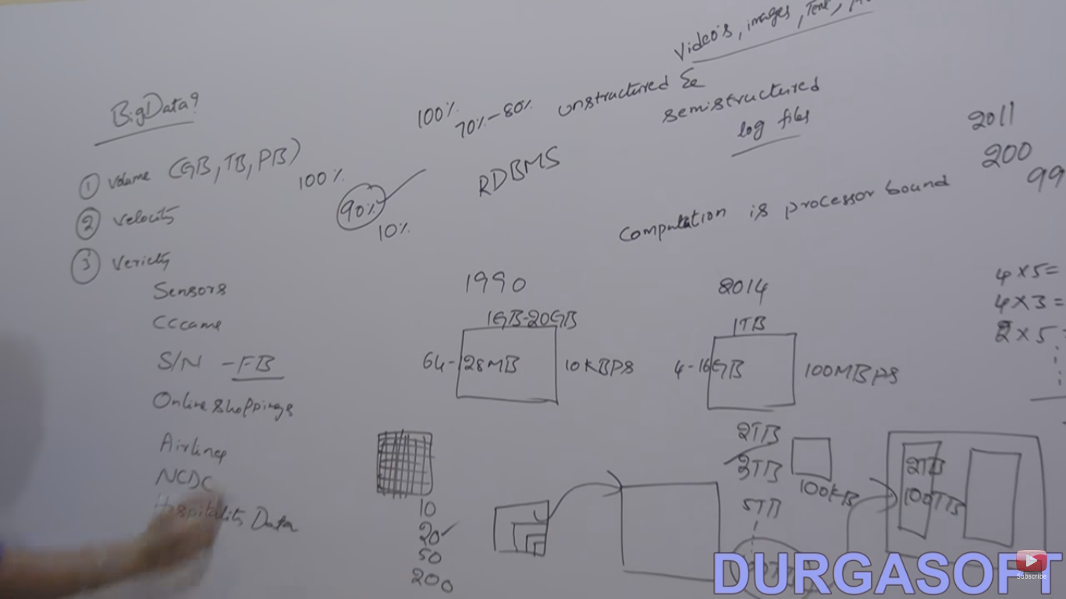

Slide 2
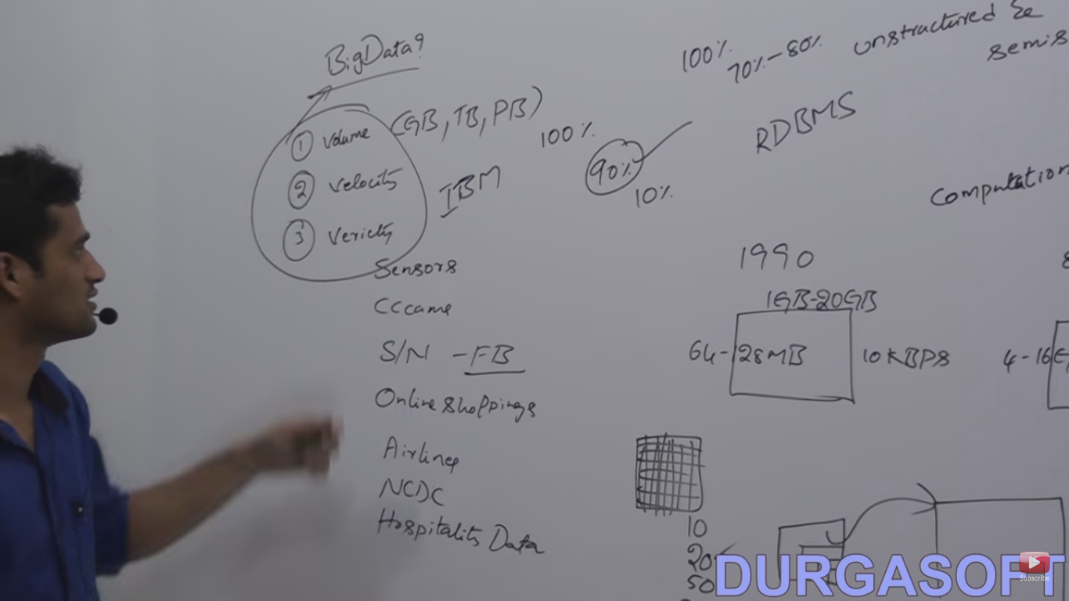

Slide 3
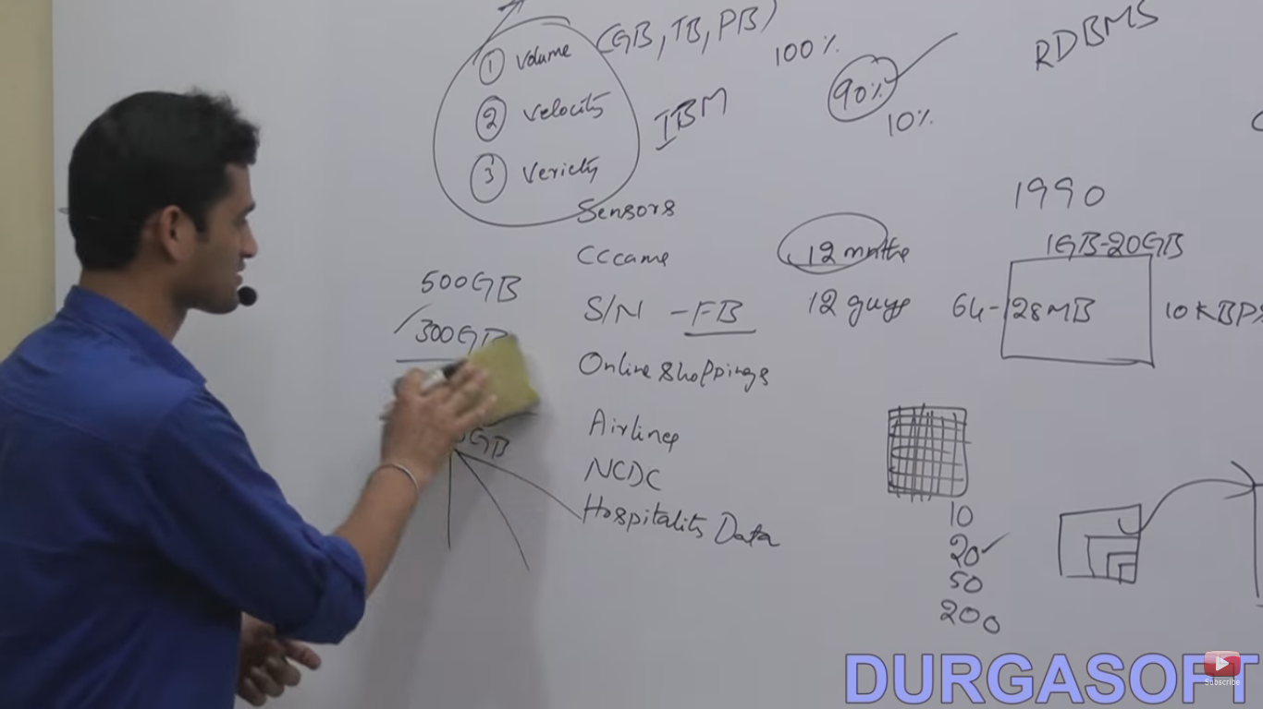

Slide 4
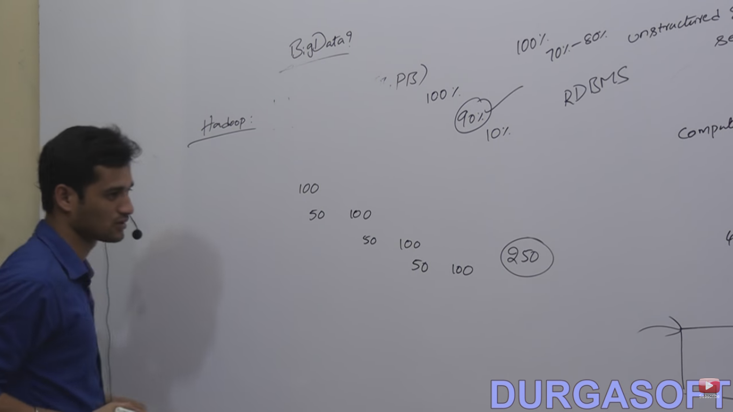

Slide 5
Hadoop
This is also a opensource framework given by apache siftware foundation.Use to storing and processing the huge dataset(Bigdata) with cluster(set of machine in a single LAN) of comodity(cheap) hardware.
Two component:
HDFS-It is a specially designed file system(block size =64MB or simple block size=4kb) for Storing the huge dataset with of comodity hardware in streaming access pattern(write once and use multiple times without change).
MapReduce-Technique to process the huge data that is stored in HDFS.

Slide 6
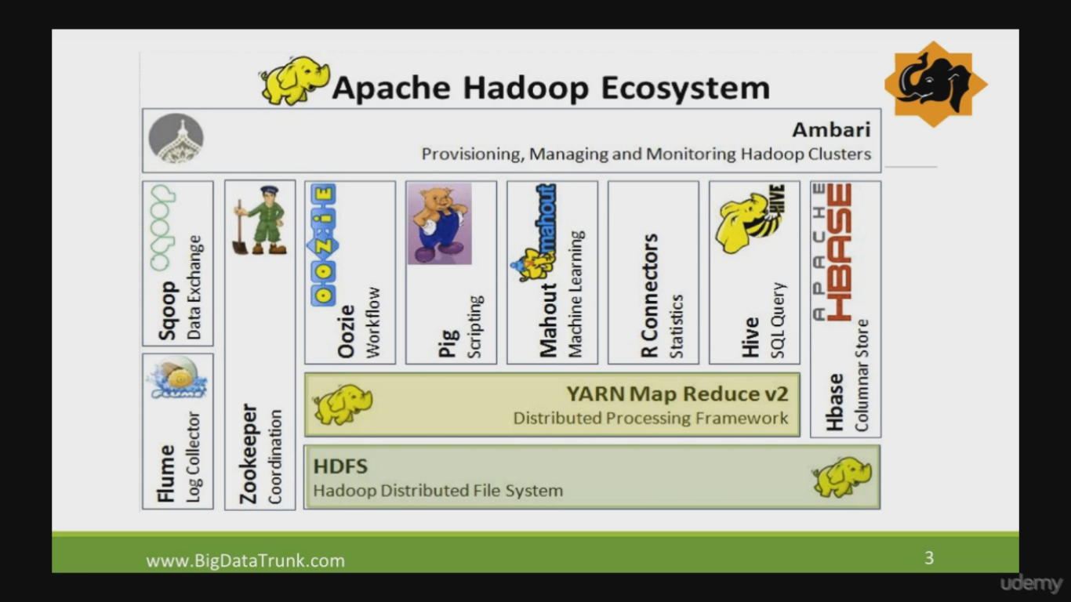

Slide 7
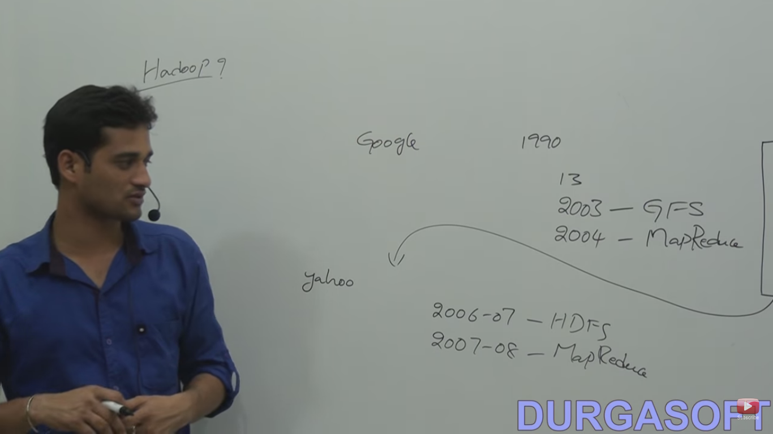

Slide 8
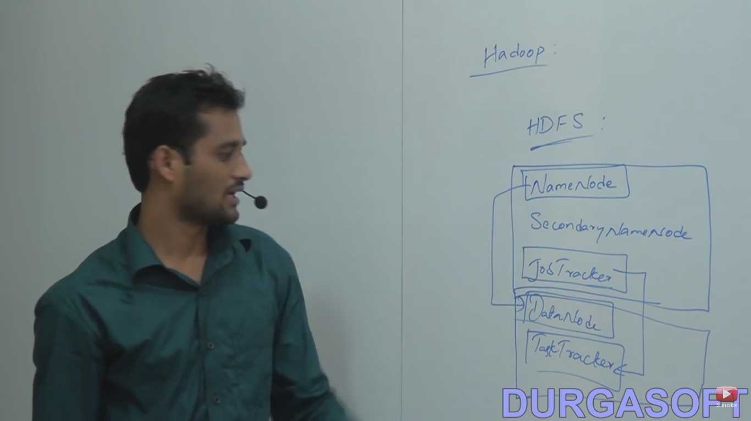

Slide 9
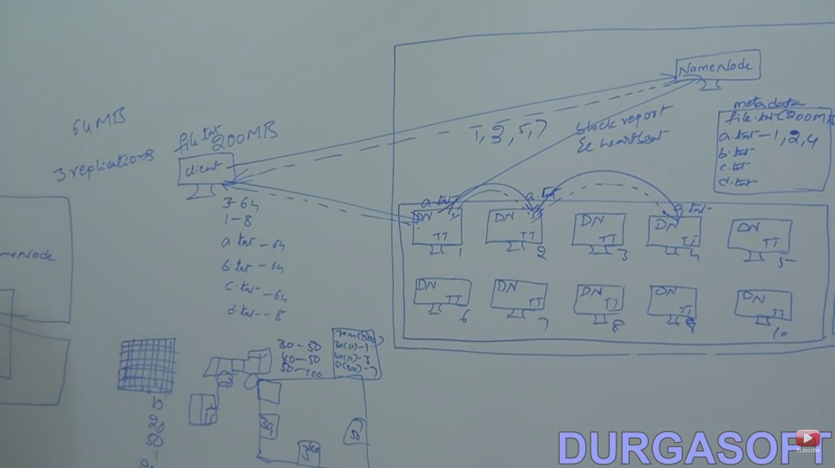

Slide 10
Namenode is single point failure because it contains the metadata. If it will lost then nothing will possible that everything will inaccessible.
So we are maintaining high reliable hardware for Namenode.
If we are running all five services in a same system then it is called single node cluster.
Other machine then called multi node cluster.

Slide 11
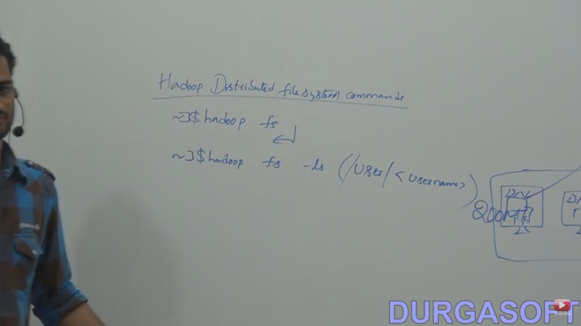

Slide 12
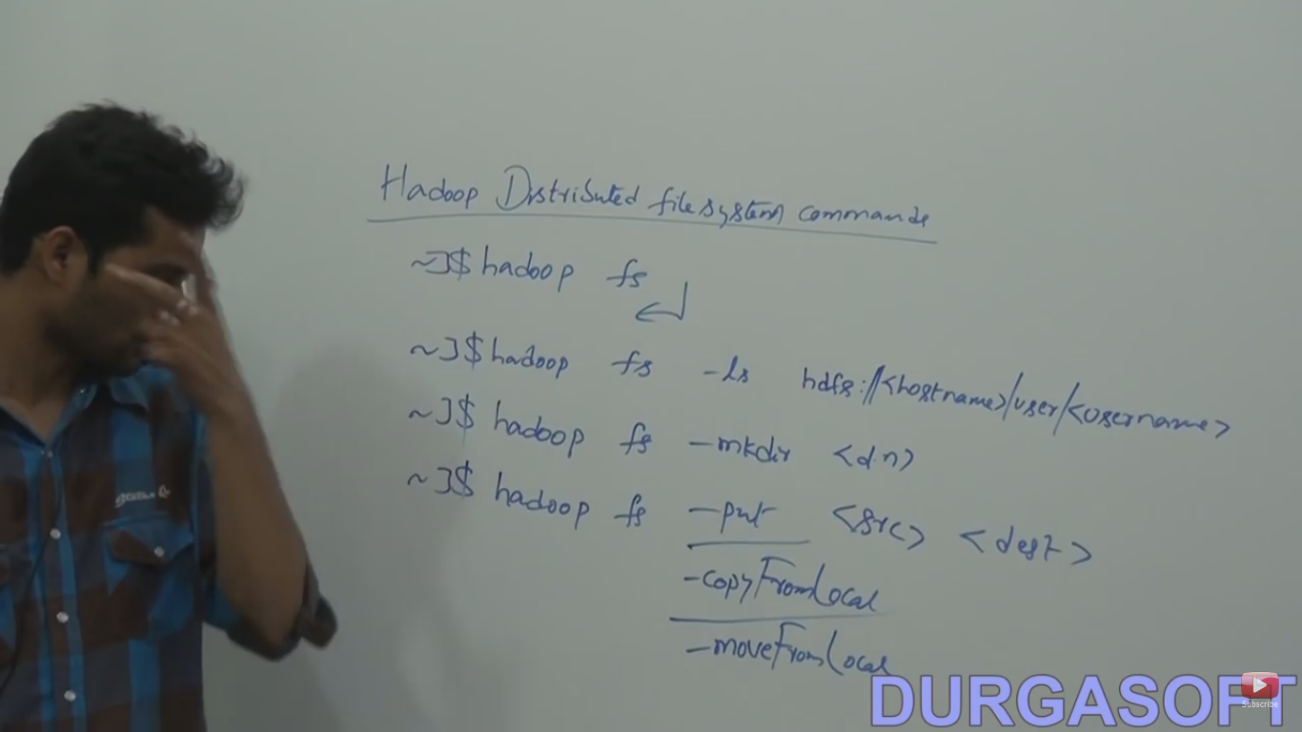

Slide 13
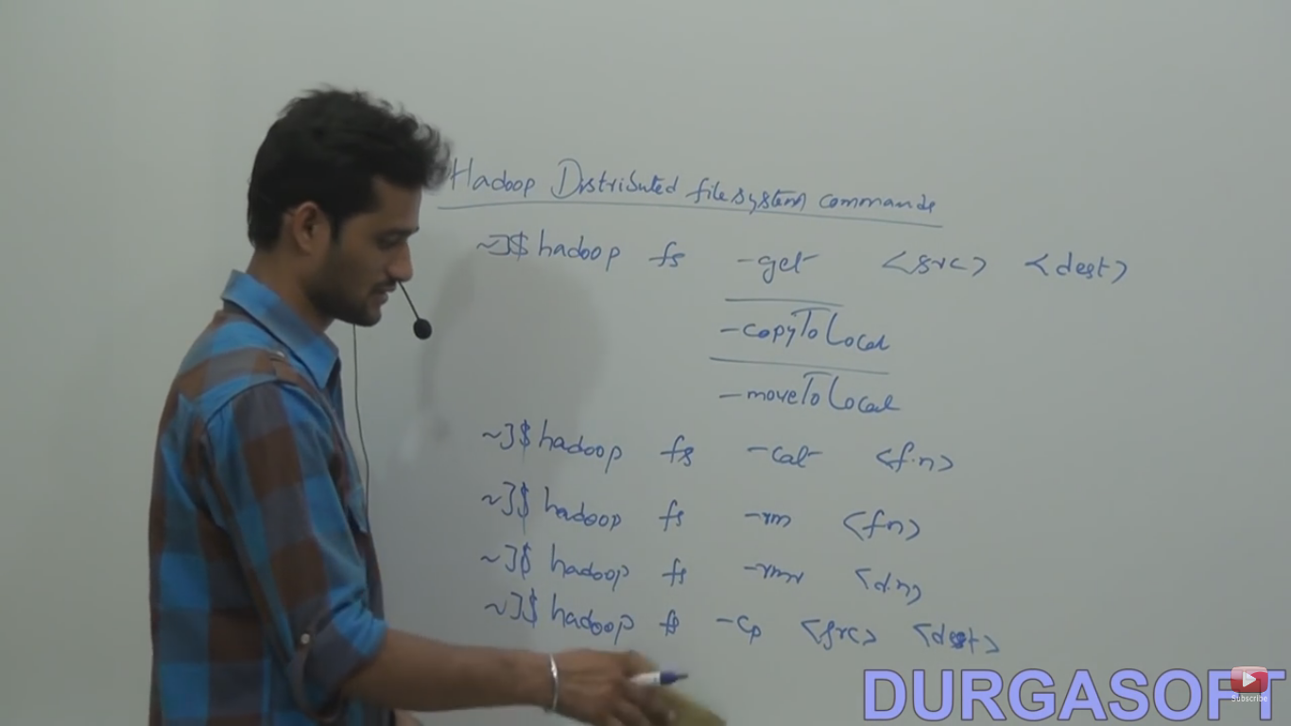

Slide 14
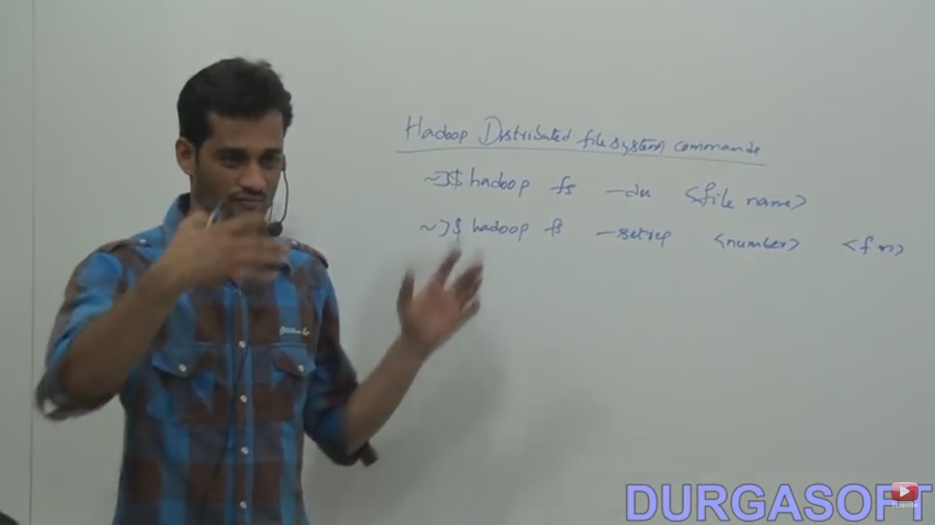

Slide 15
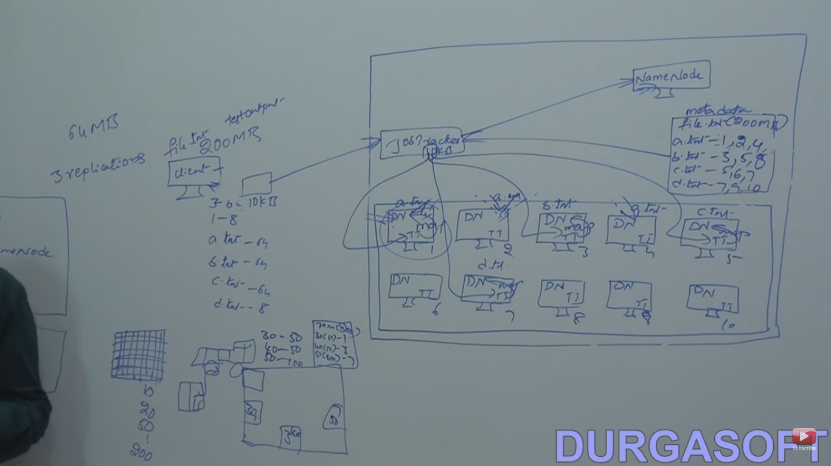

Slide 16
Input file(file.txt)
Input splits(a,b,c,d.txt)(==mapper)
Job tracker will take the request from client and assign the task to task tracker to process that is called map.
Task tracker sent heart beat at every 3 sec and slot available report. If TT is running very slowly or dead then the job tracker will wait for 10 hb(30s) after that it will assign to any other TT.

Slide 17
Job tracker is also single point failures because it contains all the task. If it will lost then nothing will possible that everything will inaccessible.
So we are maintaining high reliable hardware for Job tracker .
Output file(==reducer)
Identity mapper and reducer are there bydefault.
If we run our job locally then local jobrunner will take care of that.

Slide 18
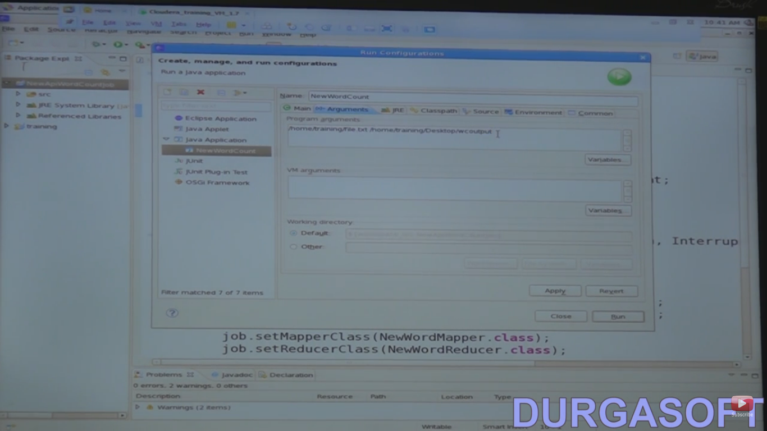

Slide 19
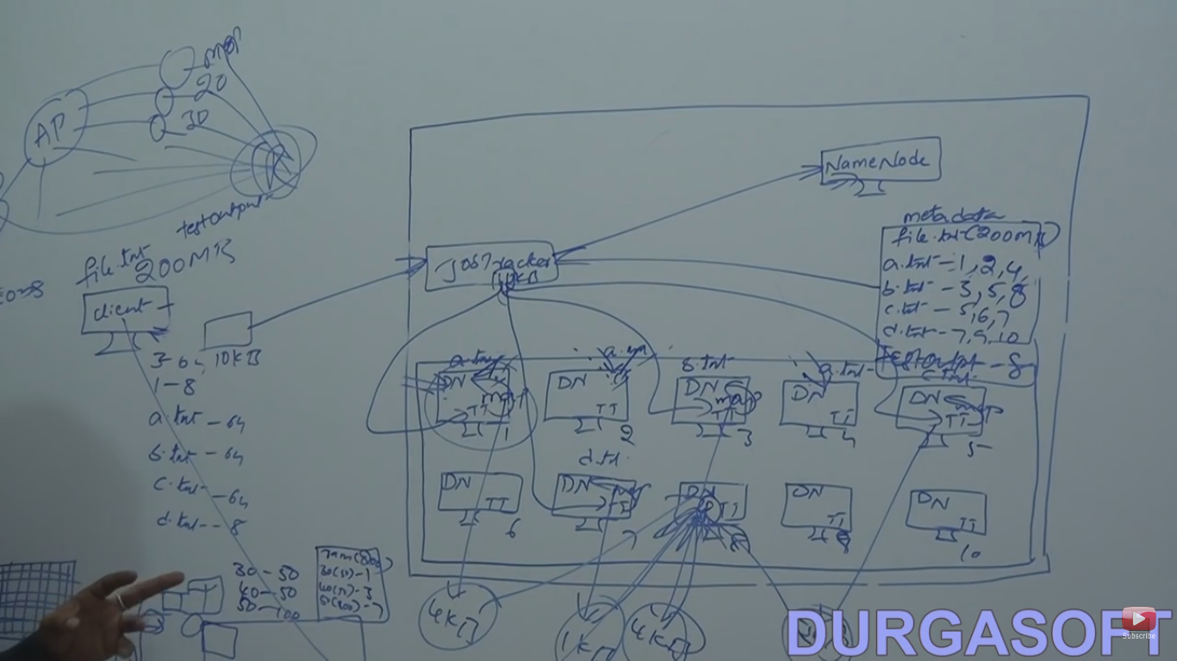

Slide 20
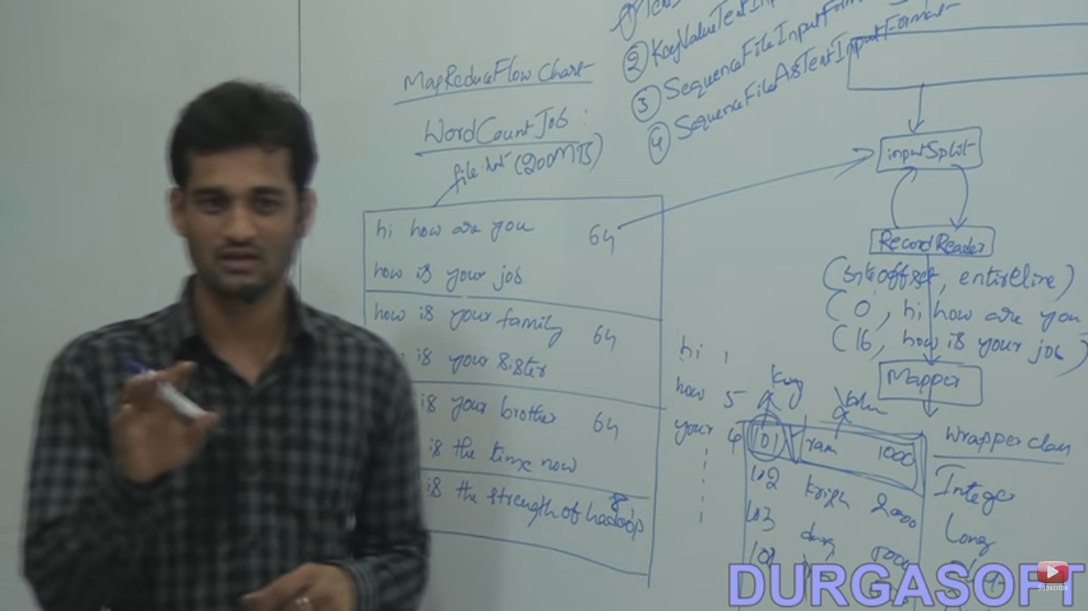

Slide 21
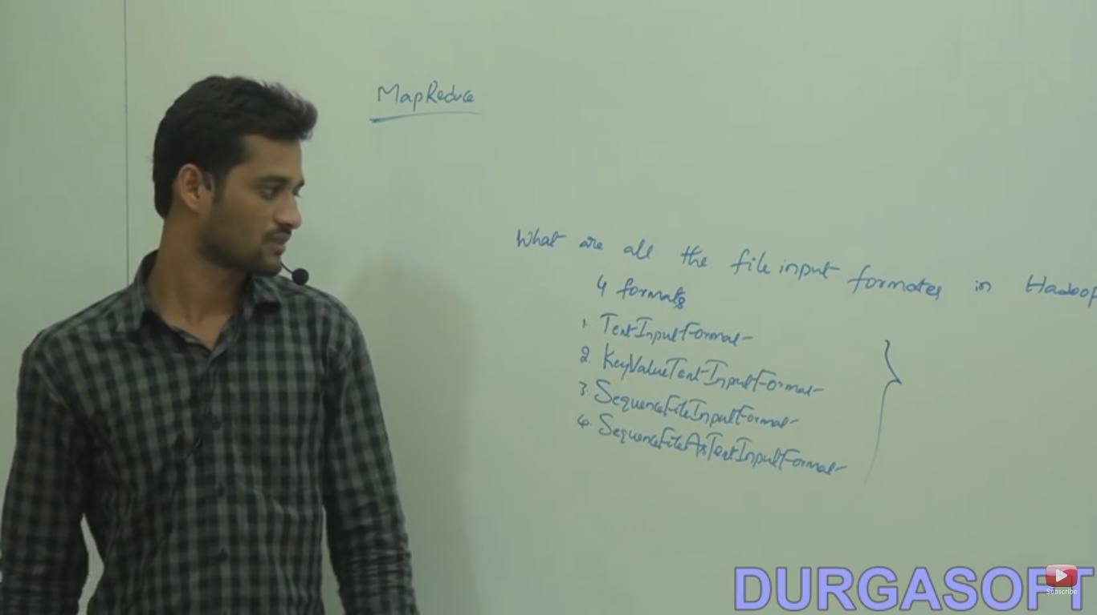

Slide 22
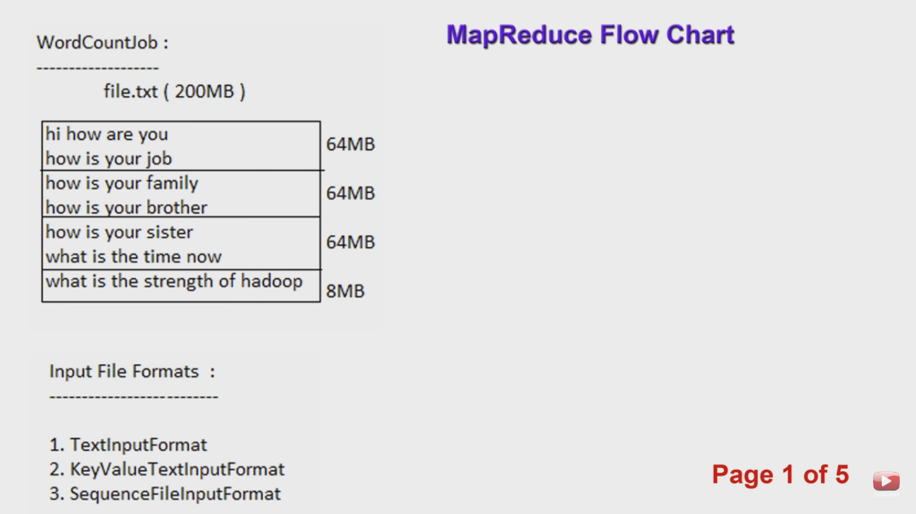

Slide 23
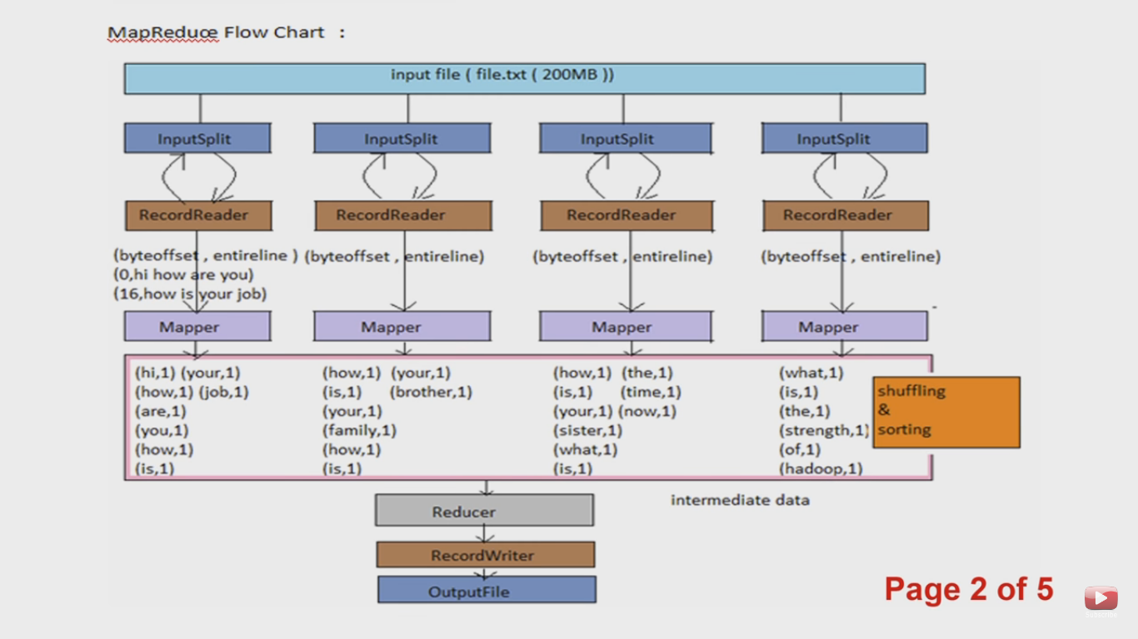

Slide 24
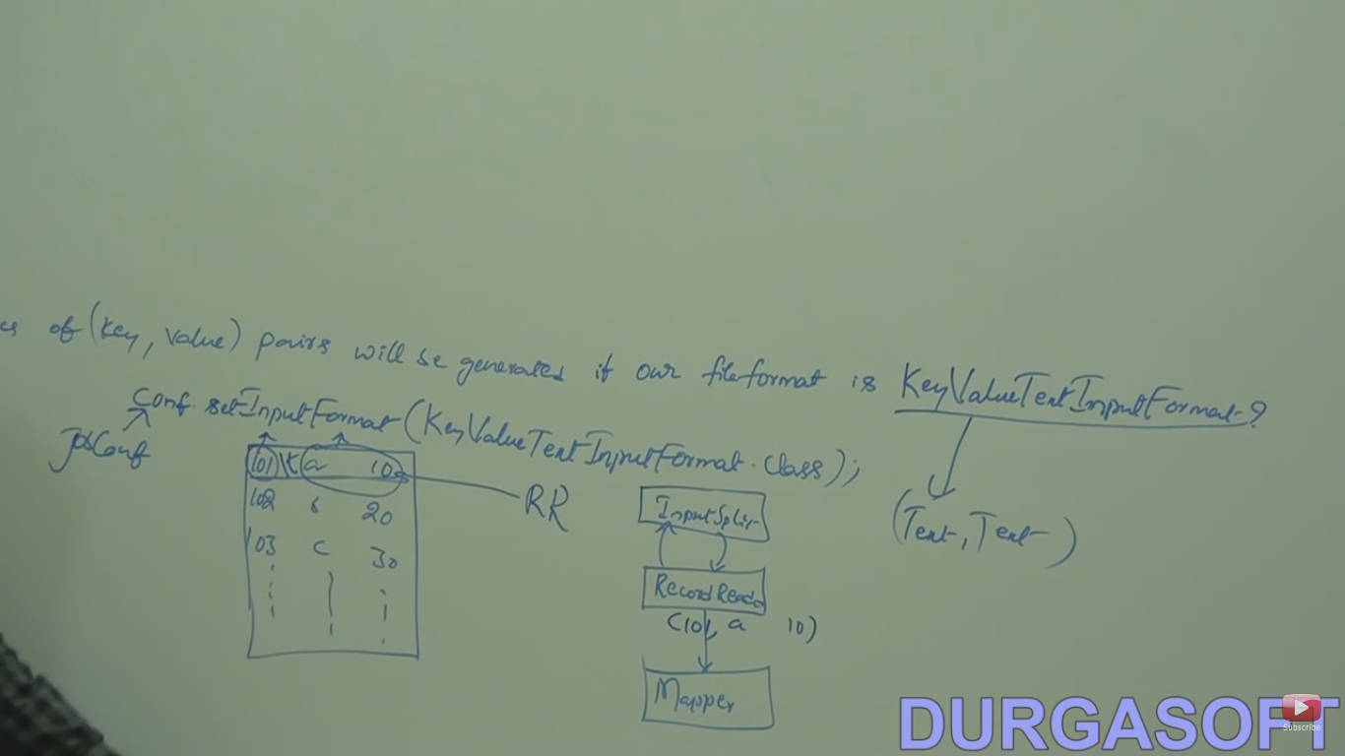

Slide 25
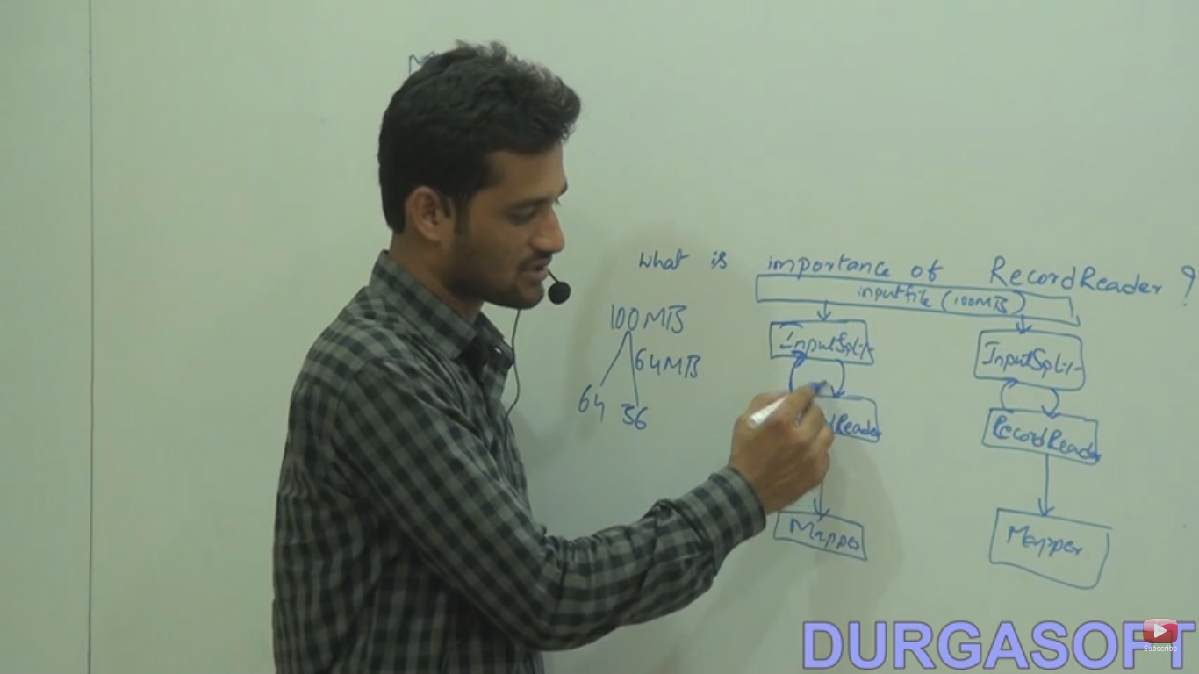

Slide 26
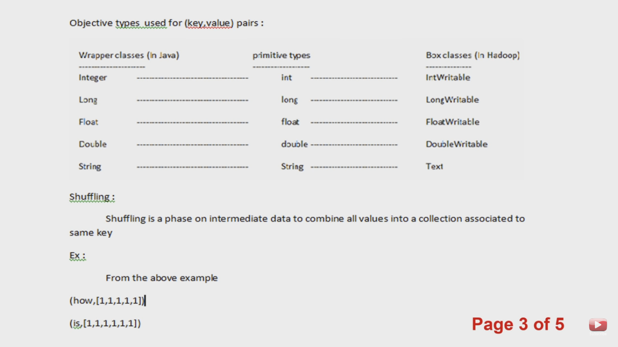

Slide 27
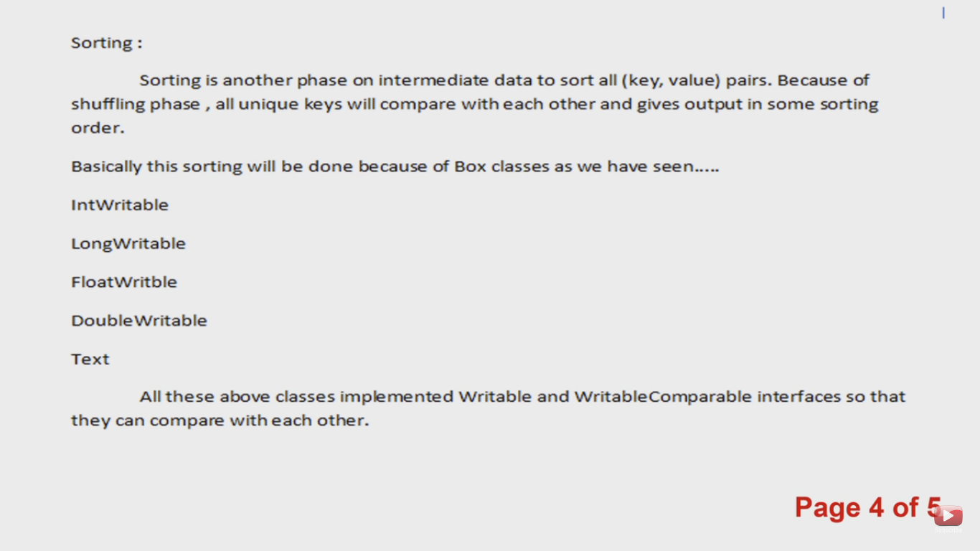

Slide 28
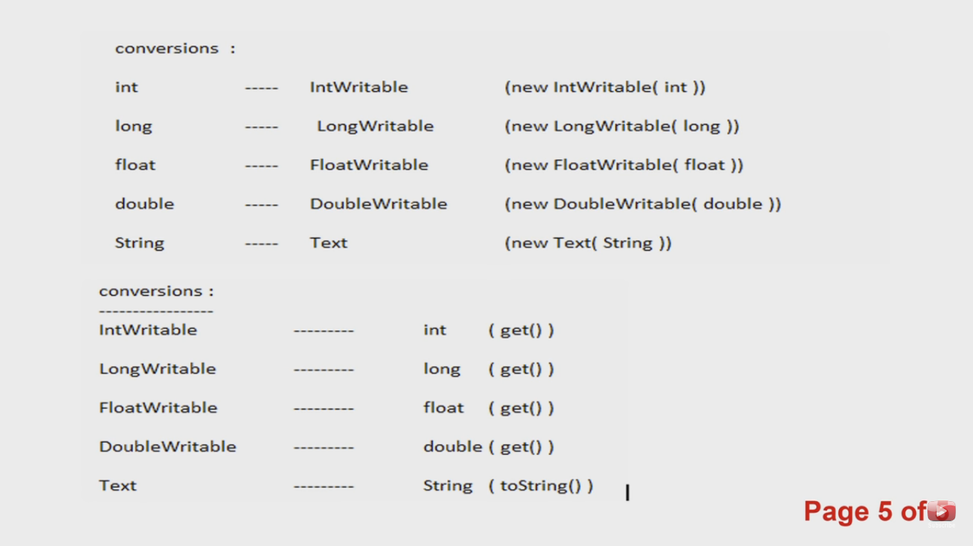

Slide 29
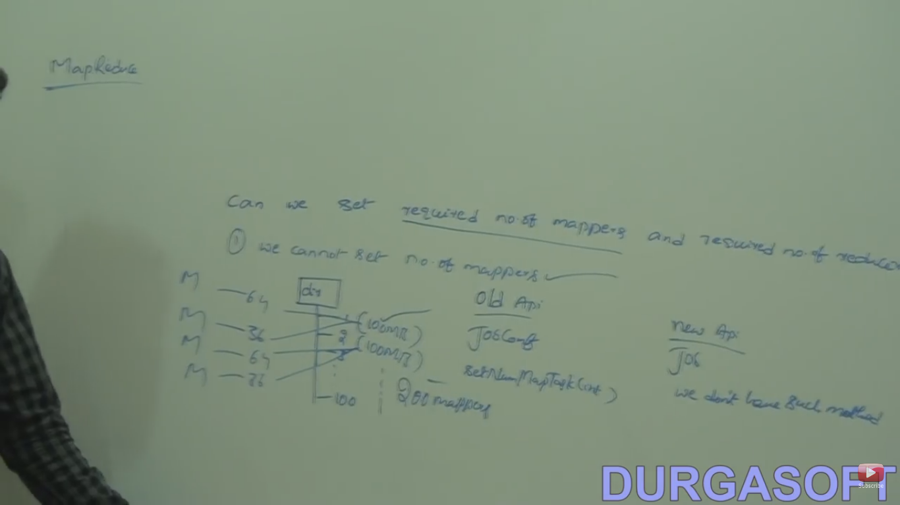

Slide 30
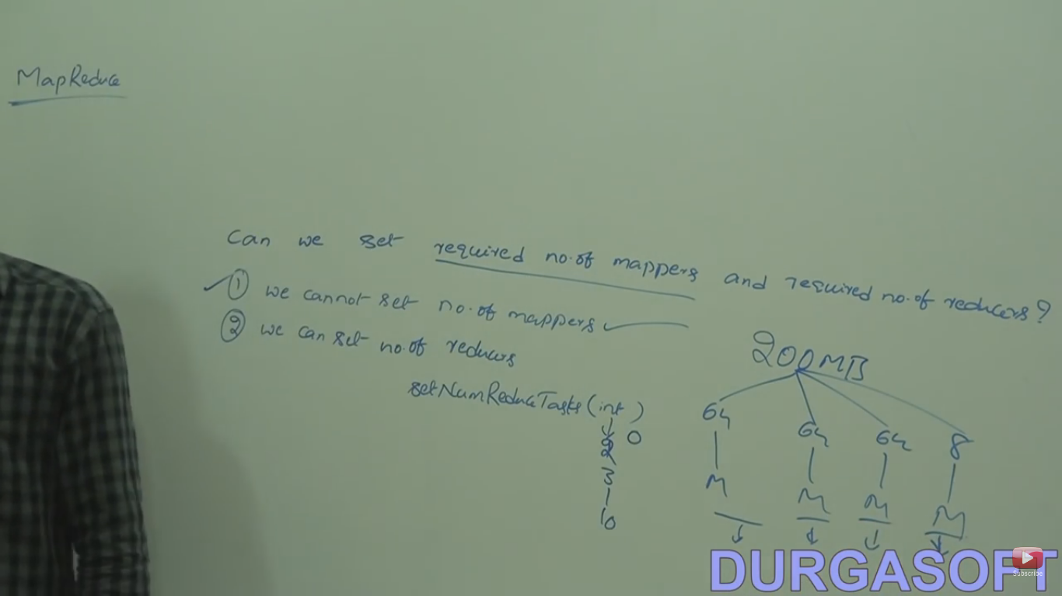

Slide 31
Combiner
Giving more performance on application by decreasing network the traffic.
It is mini reducer.
Combiner no(==mapper).
Taking mapper output and doing shuffling and sorting and producing some output for reducer.

Slide 32
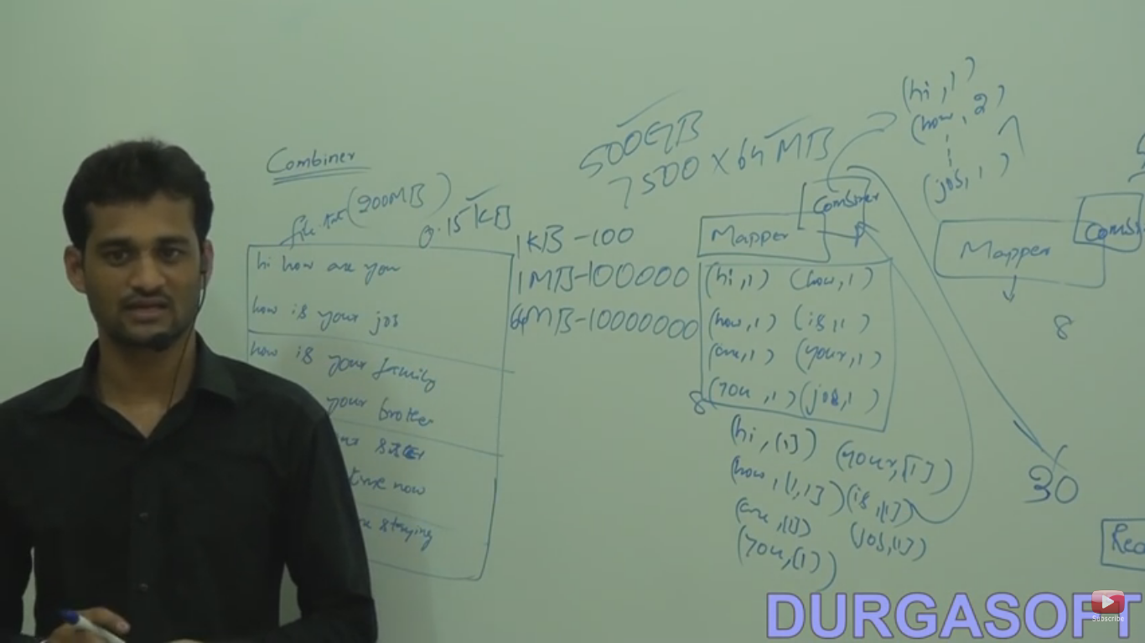

Slide 33
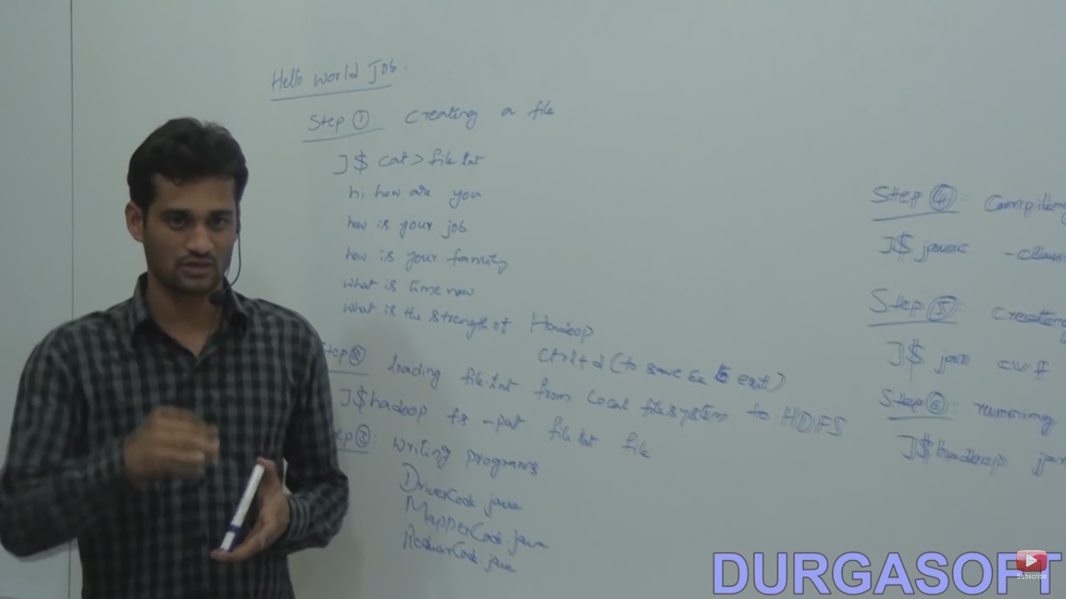

Slide 34
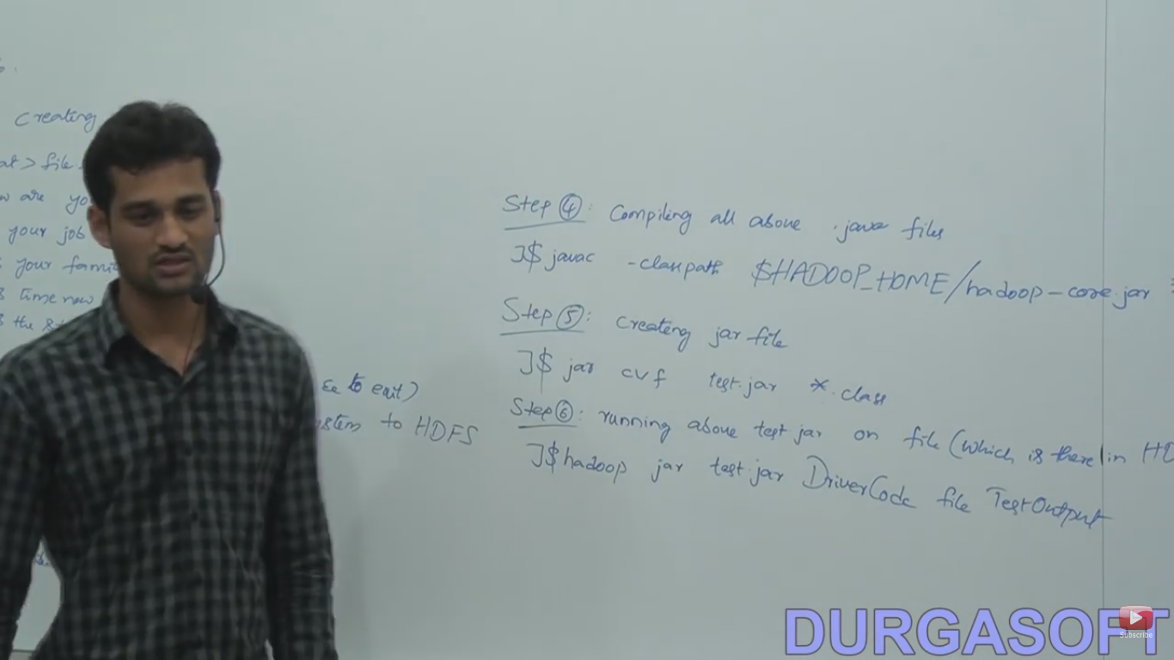

Slide 35
Partitioner
Use to increase performance of an application.
Default Partitioner is HashPartitioner class is available.
Used to split the intermidiate output between multiple reducer based on hashcode of object.
It can not send the specific object to specific reducer so we have to write our own partitioner class.

Slide 36
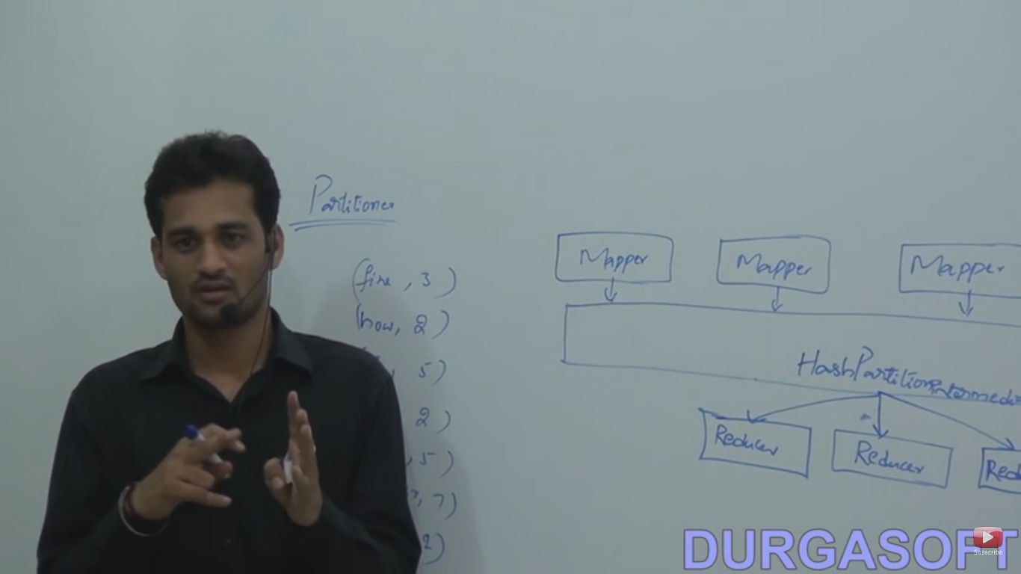

Slide 37
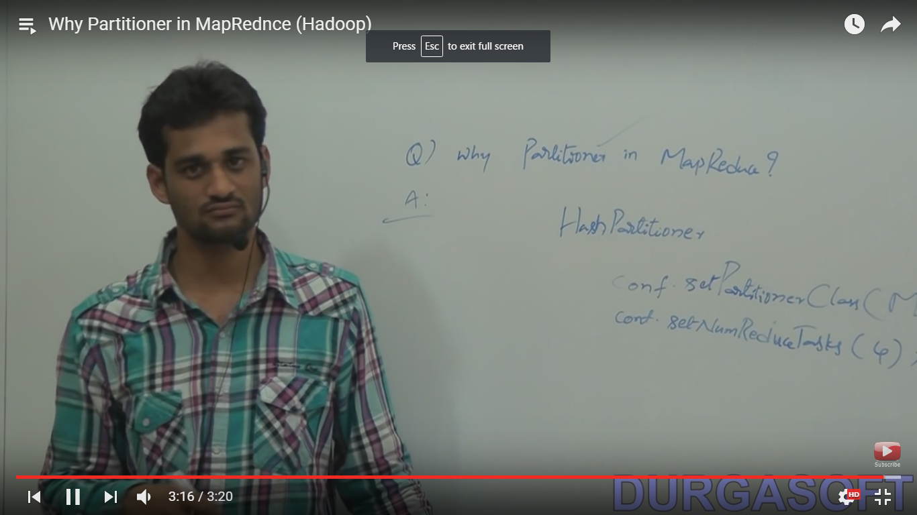

Slide 38
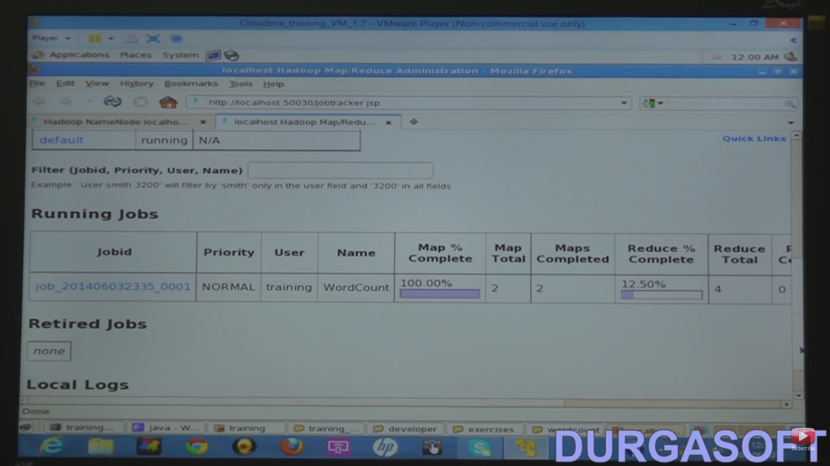

Slide 39
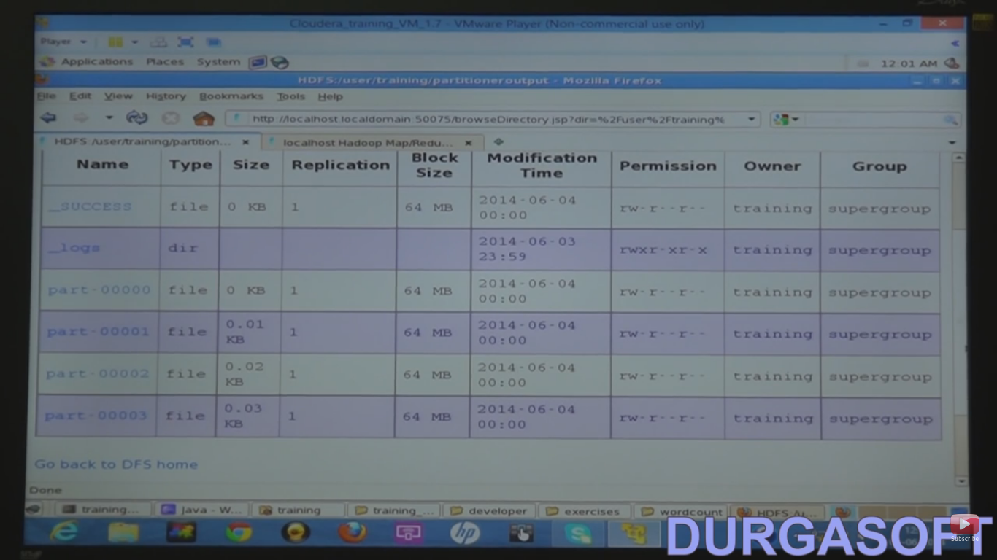

Slide 40
Sqoop
Used to import data from RDBMS to HDFS or exporting data from HDFS to RDBMS.
Bydefault mapper=4.
Can set no of mapper using command –m <n>.
It only work with four mapper bydefault but not reducer.

Slide 41
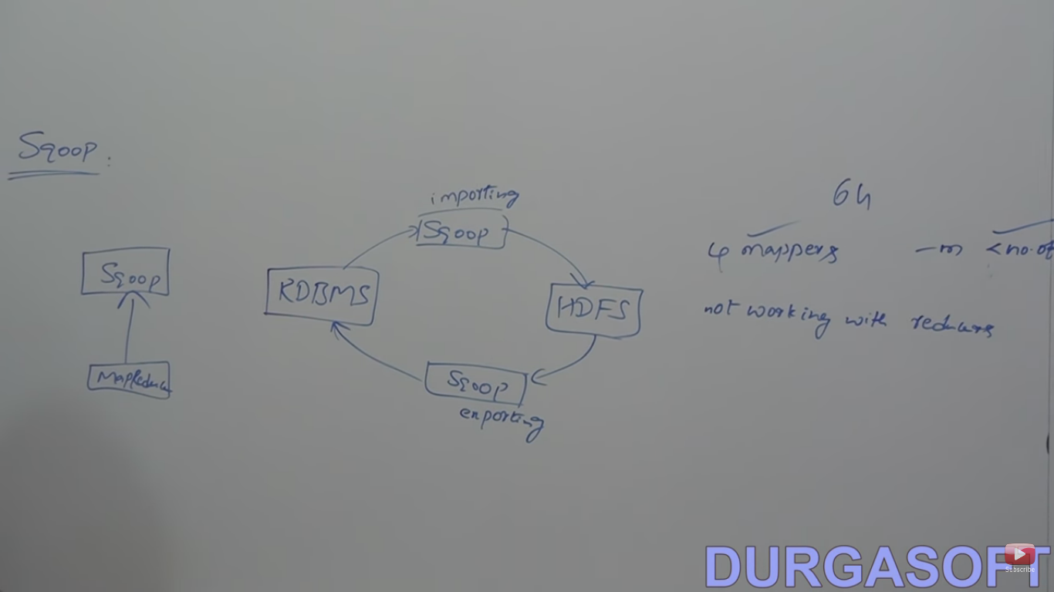

Slide 42
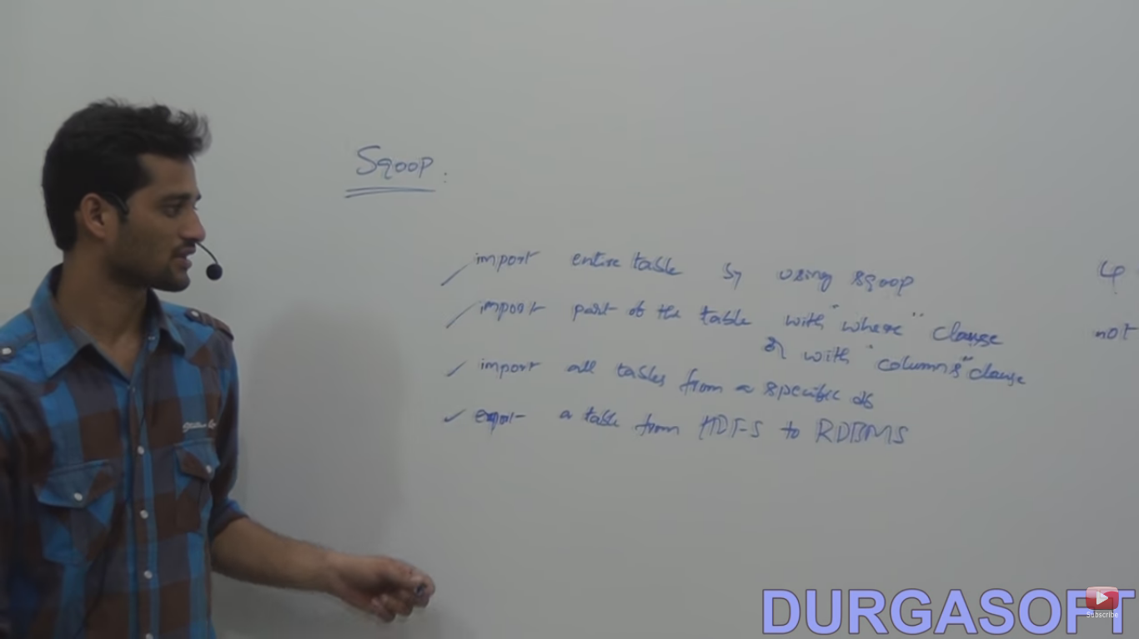

Slide 43
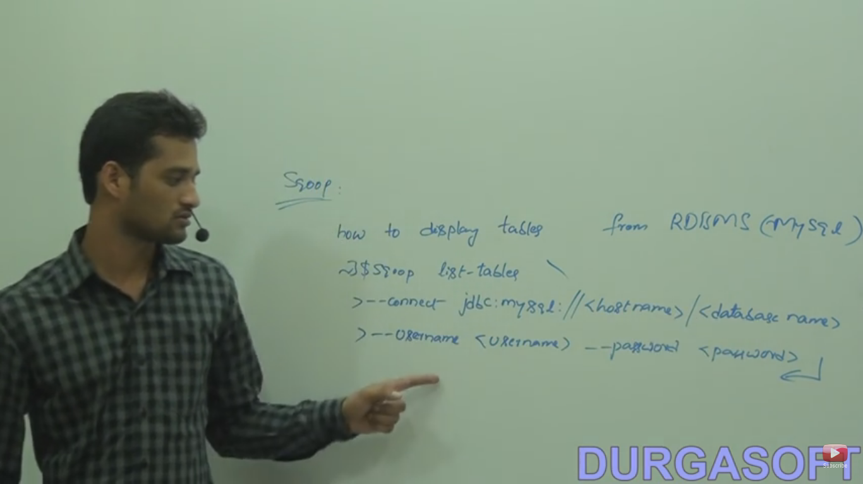

Slide 44
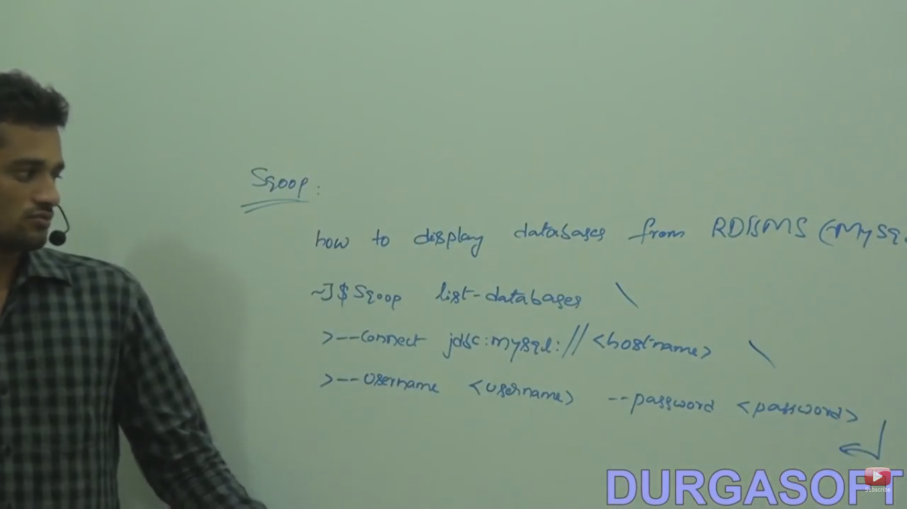

Slide 45
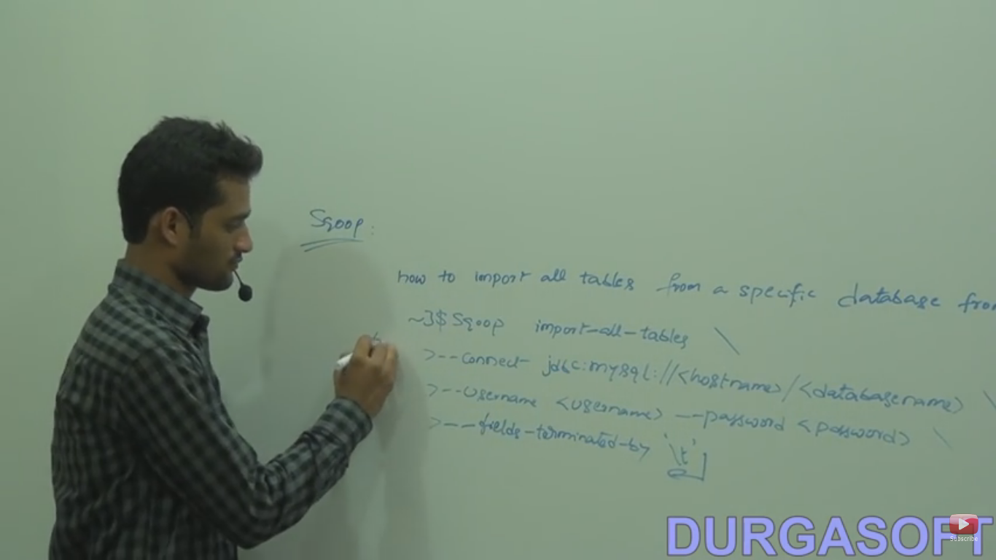

Slide 46
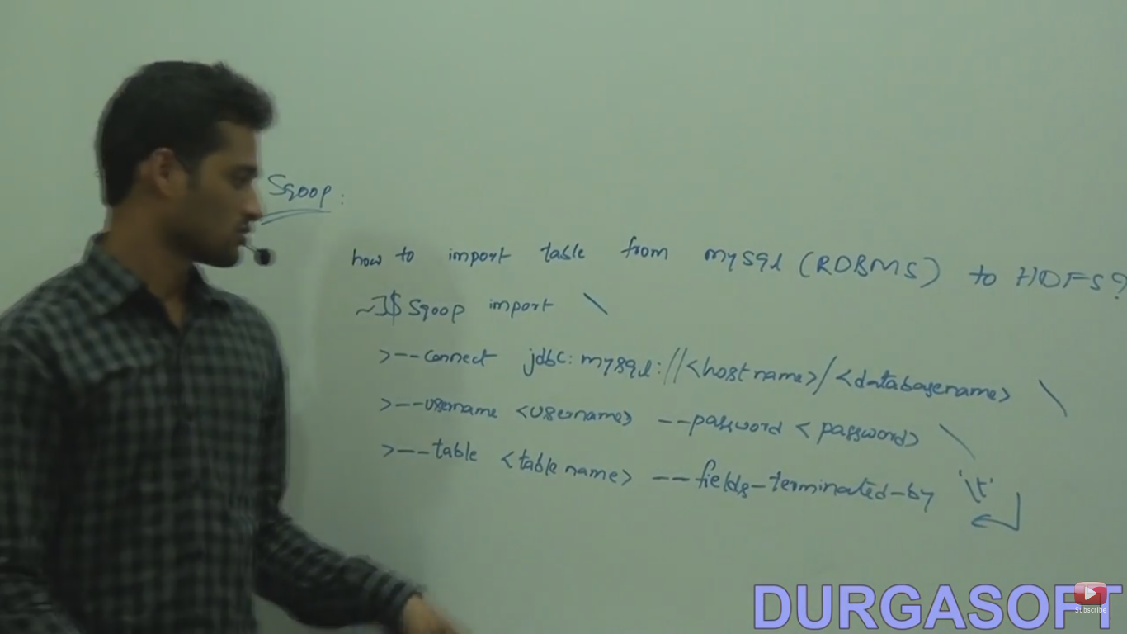

Slide 47
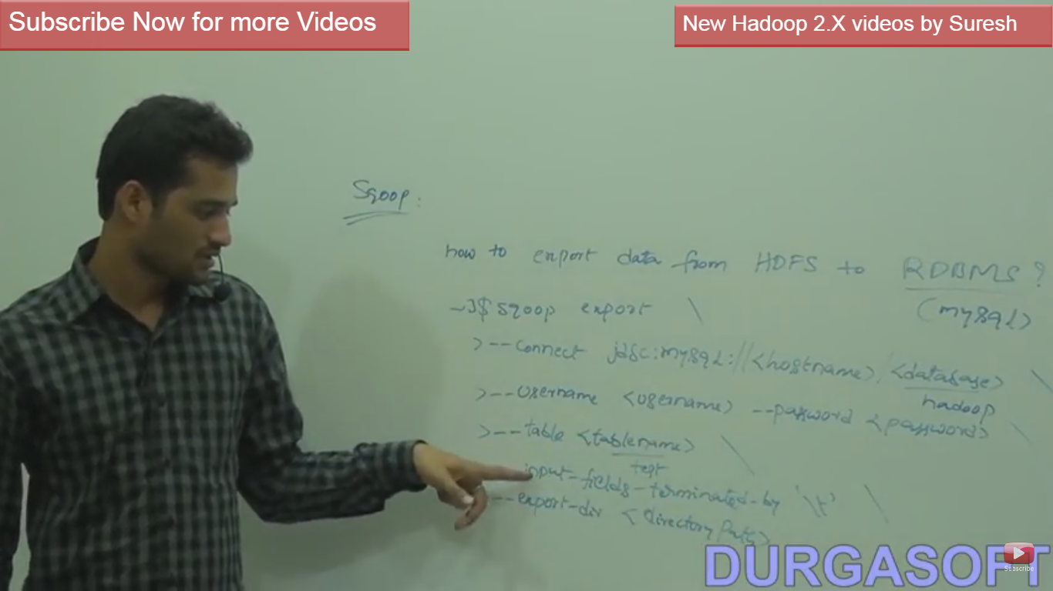

Slide 48
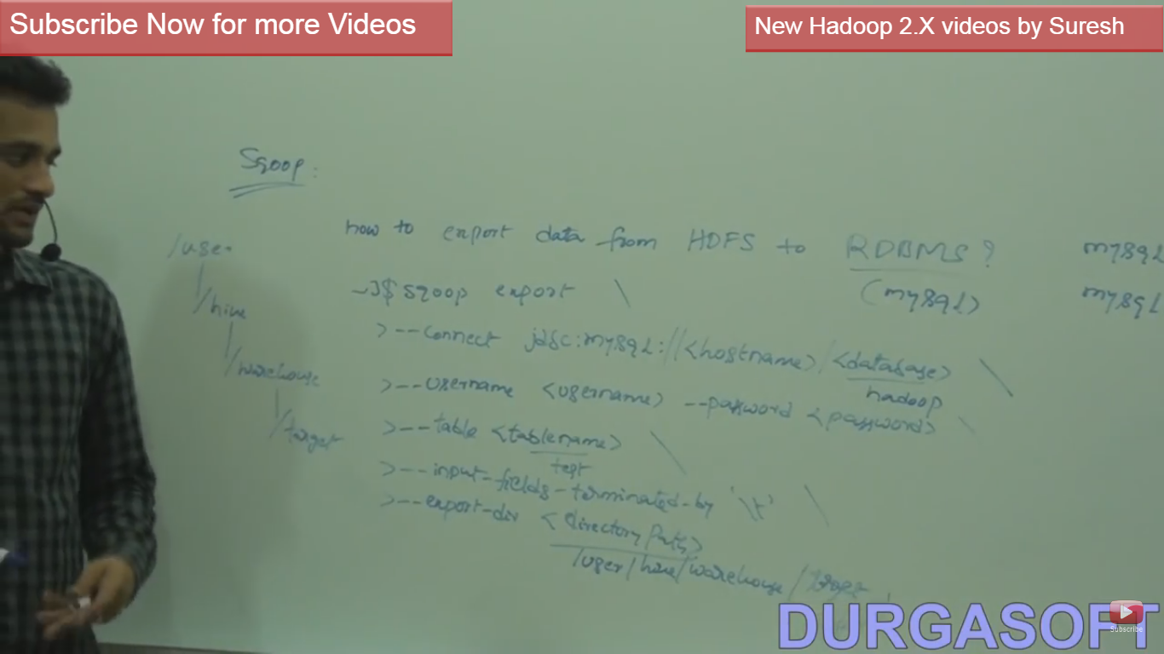

Slide 49
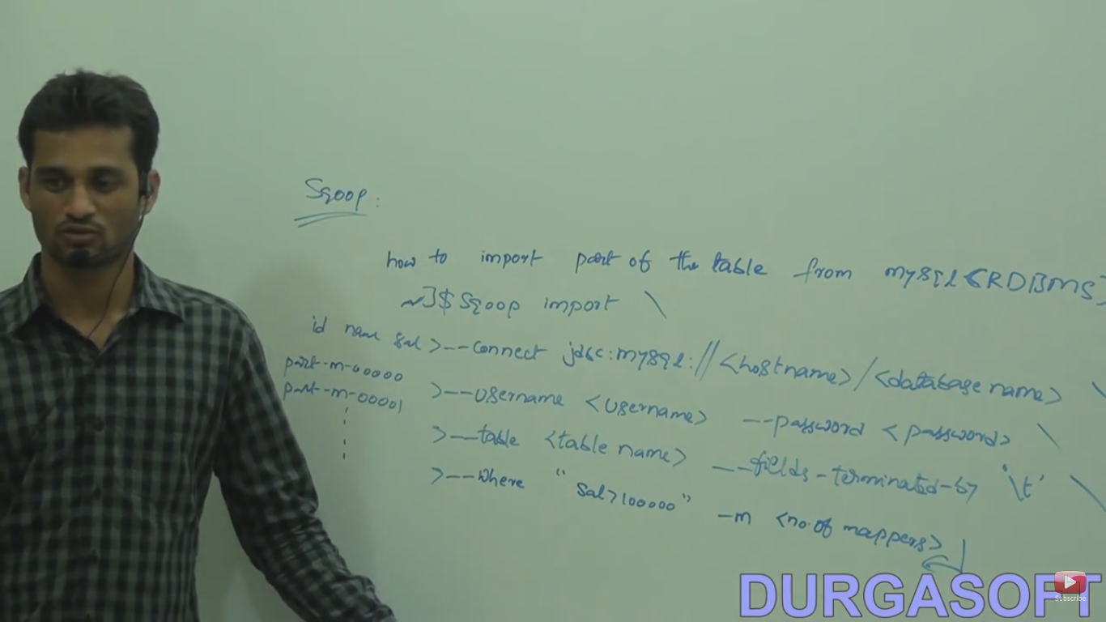

Slide 50
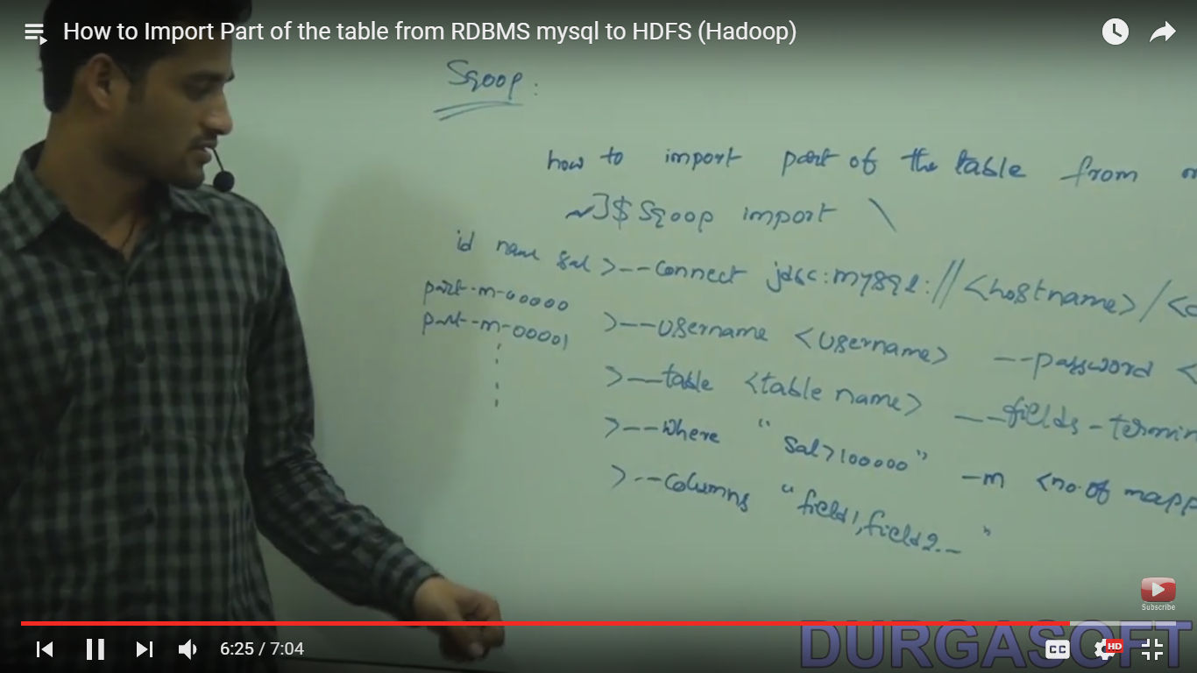

Slide 51
HIVE table
Used to process structured data.
Used for non java programmer.for java programmer use MapReduce.
Load data from local file system or HDFS.
Support HiveQl given by facebook.
These table also stored in HDFS so every table has created as directory.
Two way to create tables:
1)Managed table or internal table: Here we can create bulk data or schema in any order. If both are match then it will display the data and not matched then will display null.
Scema will store into metastore and data will insert into warehouse.

Slide 52
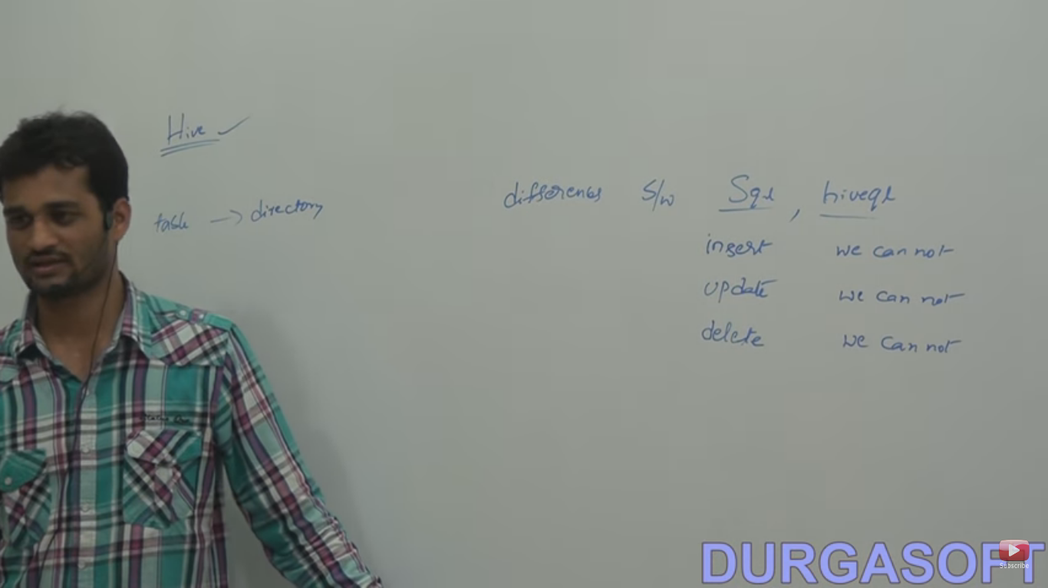

Slide 53
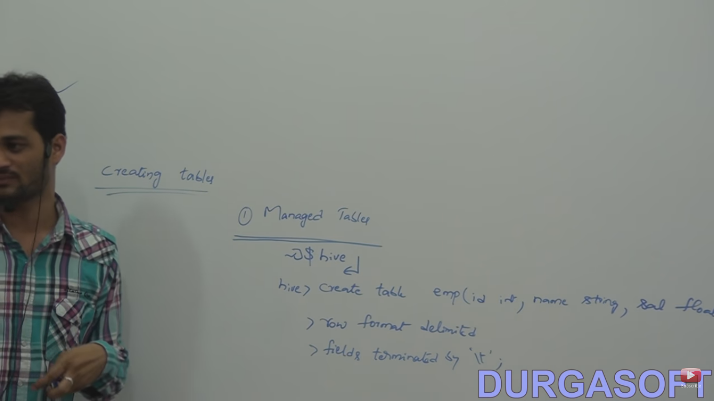

Slide 54
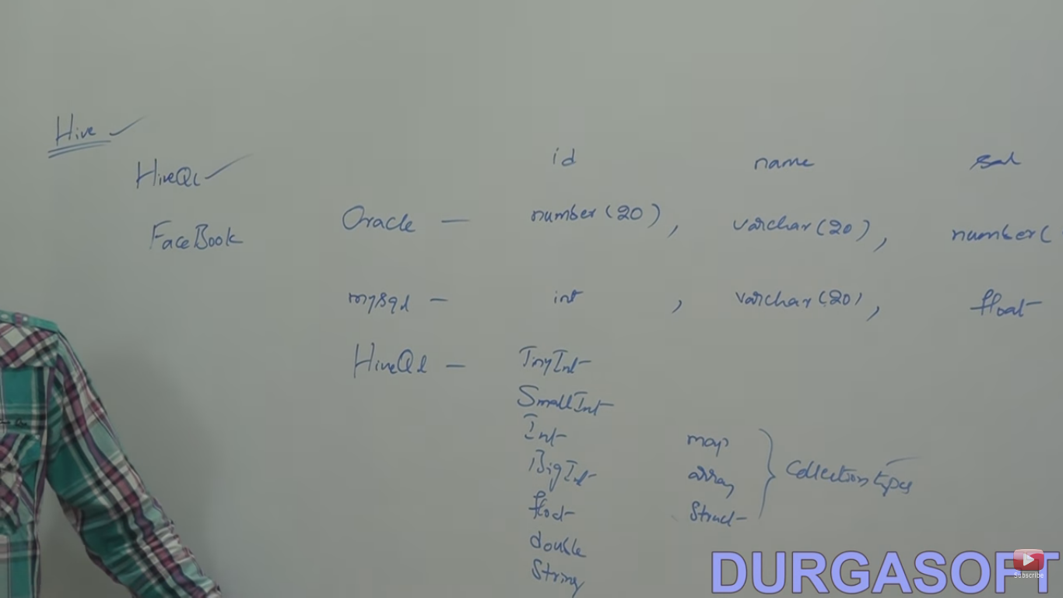

Slide 55
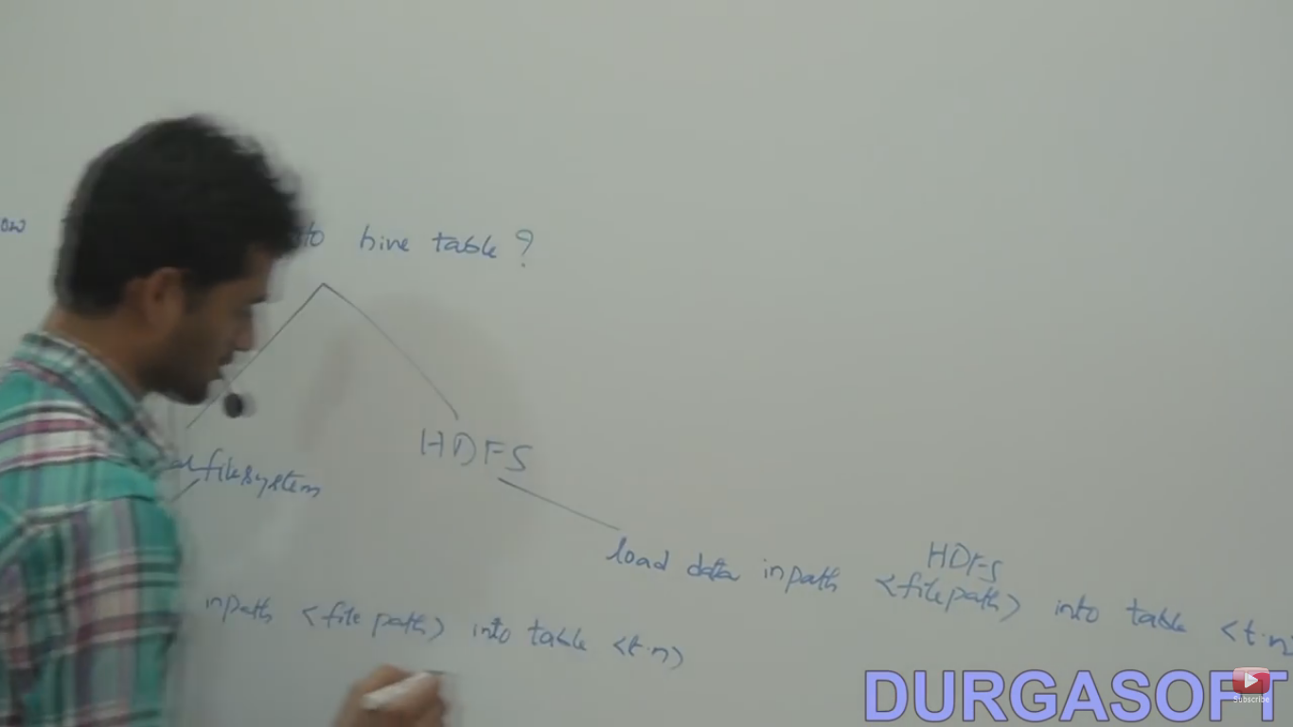

Slide 56
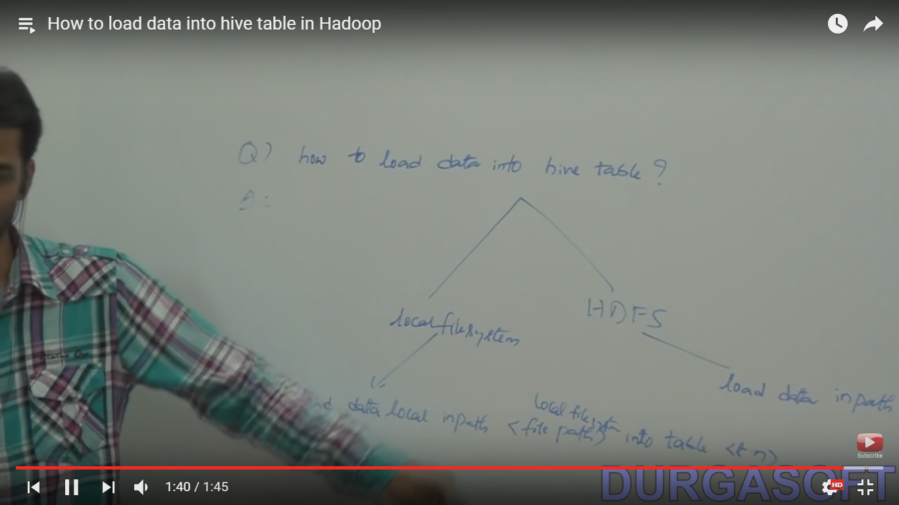

Slide 57
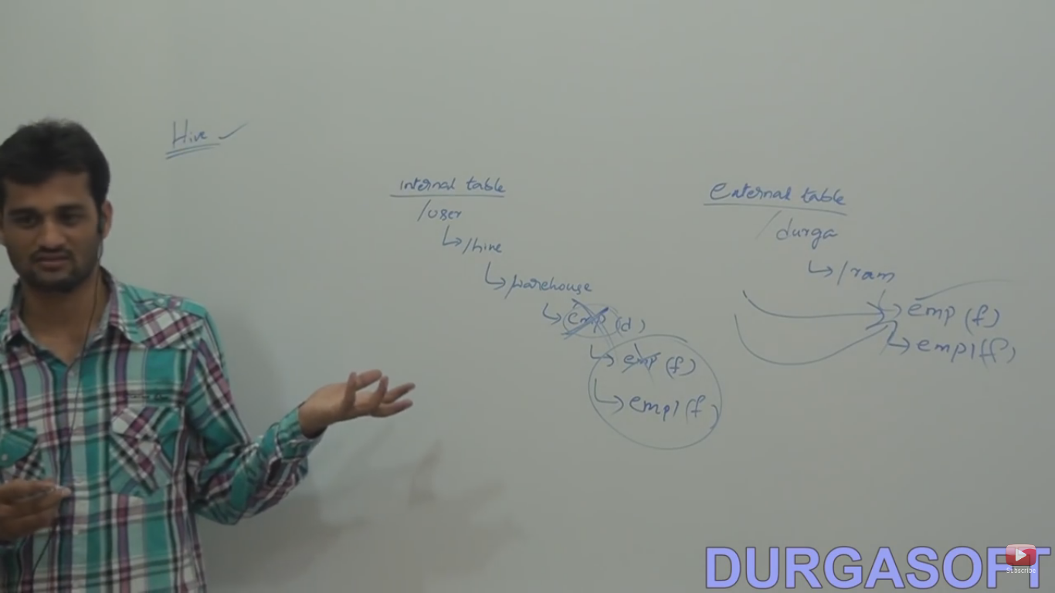

Slide 58
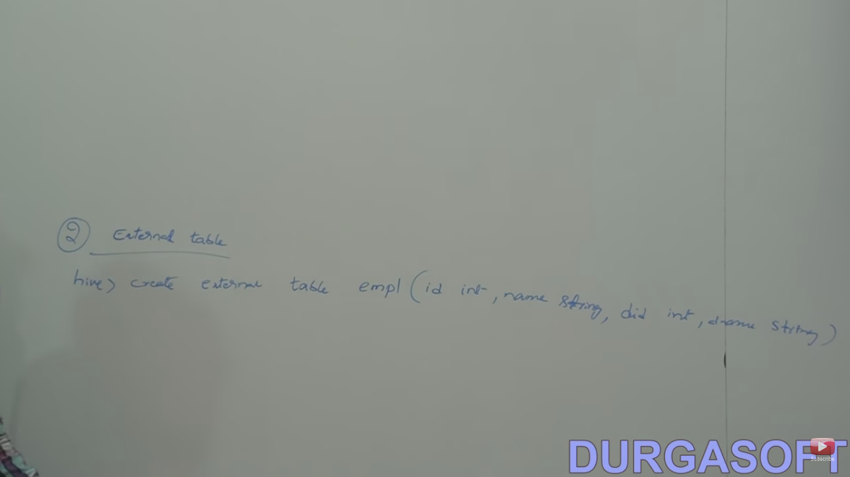

Slide 59


Slide 60
Oozie
This is a server.
Like a work flow engine.
Coordinate multiple jobs and give final output.
Two nodes:
Control node : Take care of from where job should be started.
Action node : Take care of how job will start one at a time.
Contain only one control tag but action tag=no of jobs.
Oozie server contains workflow.xml file where all job configuration will be present.

Slide 61


Slide 62
Hbase
This is a noSql database that is stored data in (key , value) pair and key or value will be bytearray types.
Taking data in column format.
Using this we have to start one service Hmaster.

Slide 63


Slide 64


Slide 65
PIG
This is a pig latin scripting and it is a Data flow language.
It’s working like an interface,get the output and leave the pig.
Given by yahoo.
Built on top of MapReduce.
Used for other language other than java or sql.
It will work with bag or relation,tuple and atom.
Bag is the group of touple.
PID doesn’t have any metastore or warehouse.
Also it will work with local mode and HDFS(MapReduce) mode.
In local mode,we can’t work with HDFS data and viceversa.
Bydefault it will take as bytearray type.
Env is the bag or relation.
If we are not giving schema then it will take column like $1,$2,….

Slide 66


Slide 67


Slide 68


Slide 69


Slide 70


Slide 71


Slide 72


Slide 73


Slide 74
XML file in Hadoop
core-site.xml : setup for metadata.
Mapred-site.xml : Setup for all jobs.
Hdfs-site.xml : Contain no of replication setup and also the location setup for intermediate data.
Without this configuration fine we can’t run our job, It means our services won’t be started.

Slide 75


Slide 76


Slide 77


Slide 78


Slide 79


Slide 80


Slide 81


Slide 82


Slide 83


Slide 84
Create the file but Touch command can’t allow to add text.For that we have to go cat or vi command.

Slide 85


Slide 86


Slide 87


Slide 88


Slide 89


Slide 90


Slide 91


Slide 92


Slide 93


Slide 94


Slide 95
Partitions in Hive
When I execute query on whole database then our performance will be down.
So I will apply partition on our DB and apply the query on partitions then our perfomanve will high.

Slide 96


Slide 97


Slide 98


Slide 99


Slide 100


Slide 101
Word count job with new API

Slide 102


Slide 103


Slide 104


Slide 105
Single and multi table insertion
Apply the query on one table and keep the output in another table is called single table insertion.
Split one table data into multiple table.

Slide 106


Slide 107


Slide 108
Configure i/o directories in DriverCode(hadoop mapreduce)

Slide 109


Slide 110


Slide 111
Flume
Use to collect the large amount of logs data from webserver(e.g. twitter, facebook etc)and store into HDFS for further processing.
Also called log collector.

Slide 112


Slide 113


Slide 114


Slide 115


Slide 116


Slide 117


Slide 118


Slide 119


Slide 120


Slide 121


Slide 122
Command to execute flume

Slide 123
Zookeeper
It is a coordination service for distributed application.
Work on cluster envoirnment.
Solve the complex problems associated with the coordination of components in a distributed application.
Also called Znodes.
Coordinate through a hierarchical namespace of data registers.
Namespace will look similar to a unix file system.

Slide 124


Slide 125


Slide 126


Slide 127


Slide 128


Slide 129


Slide 130


Slide 131


